Slide 1


Adaptive Modulation in optical fiber communication
Mid-Review 1/2/3
Major Project
Project ID:
C7(Alpha 20)
AY 2021-25
GITAM (Deemed-to-be) University
Project Team:
SURYA TEJA J
B M K GANESH
G HEMANTH KUMAR
Department of Electrical Electronics and Communication Engineering
Project Mentor:
. Dr. Rohan Prasad
Project In-charge:
Dr Ambar Bajpai
www.gitam.edu

Slide 2
Objective and Goals
Objective
Design and Simulation: Develop a robust QPSK modulation scheme in OptiSystem to achieve a bit rate of 40 GHz over 50 km.
Performance Evaluation: Analyze key metrics such as Bit Error Rate (BER), Signal-to-Noise Ratio (SNR), and eye diagrams to assess QPSK effectiveness.
Dispersion and Attenuation Analysis: Evaluate the impact of chromatic dispersion and attenuation, exploring compensation techniques.
Comparison with Other Modulation Techniques: Benchmark QPSK performance against BPSK and QAM regarding efficiency and reliability.
Recommendations for Future Work: Suggest future research directions and potential system design improvements.
Goals
Main Goals
Achieve a bit rate of 40 GHz over 50 km of fiber optic cable.
Evaluate the performance metrics: Bit Error Rate (BER), Signal-to-Noise Ratio (SNR).
Additional Goals
.Analyze the impact of dispersion and attenuation on signal quality.
.Compare QPSK with other modulation techniques like DPSK .

Slide 3
Project Plan (Clearly mention milestone for objectives under each reviews)
week | Task
1-2 | Resarch and literature review
3-4 | Design circuit architecture
5-6 | Testing the circuit
7-8 | Collecting the feedback of the signal
9-10 | Incoporate feedback and finalize
11-12 | Documentation and presentation

Slide 4
Literature Survey (Improved post minor project)
-Author : Yequn Zhang and Ivan B. Djordjevic. -Established in year 2013. | Adaptive Modulation Implementation DWDM System Optimization Adaptive Trellis-Coded Modulation (ATCM) Performance Evaluation FEC Integration | Increased Complexity: Adaptive systems require sophisticated algorithms and hardware, raising implementation complexity. Hardware Cost: Support for multiple modulation formats can increase the cost of DACs and DSP components. Power Consumption: Adaptive systems may consume more power due to dynamic adjustments and processing. Error Handling: Adaptation may complicate error handling and recovery processes. System Stability: Frequent modulation changes can affect system stability and performance consistency.
Author and Established year Methodology Drawbacks
4

Slide 5
Authors: Xiaofeng Gao, Feng Tian, Qi Zhang, Qinghua Tian, Yongjun Wang, Leijing Yang, Xiangjun Xin Established Year: 2021 | Multi-Carrier Utilization: Employ FFT/IFFT to manage subcarriers, enhancing spectral efficiency. Dynamic Allocation: Adjust bit and power allocation in real-time based on channel conditions. Adaptive Modulation: Modify transmission parameters to optimize performance per channel band. Bit Allocation: Apply Hughes-Hartogs algorithm for efficient bit and power distribution. Simulation: Validate performance using MATLAB for various multi-carrier symbols and conditions. | Complexity: Adaptive modulation increases system complexity and computational load. Latency: Real-time adjustments may introduce latency. Cost: Advanced technology can lead to higher implementation costs. Compatibility: May not be compatible with existing infrastructure. Error Handling: Sensitive to noise and signal degradation in various bands.

Slide 6
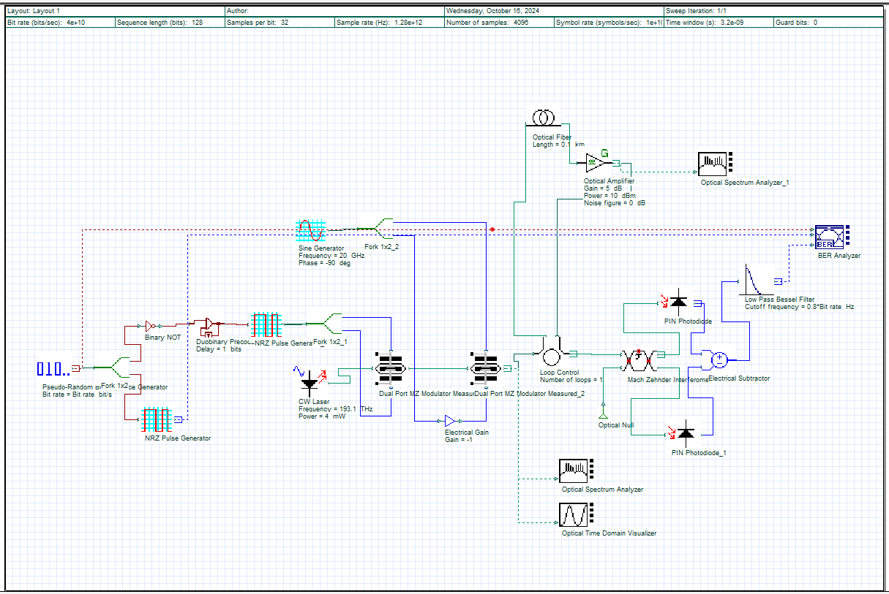
Architecture

Slide 7
Use Cases & Testing
Use Cases
High-speed internet service providers – Delivering fast and reliable internet connectivity.
Data transmission in metropolitan networks – Enabling efficient communication in urban areas
Applications in IoT and smart cities – Supporting connected devices and smart infrastructure
Enterprise and data center connectivity – Ensuring secure, high-speed communication for businesses.
5G and telecommunications networks – Powering next-generation mobile networks with low-latency connections.
Cloud computing and storage – Facilitating seamless data access and large-scale data transfers.
Streaming services and online gaming – Enhancing performance for bandwidth-intensive applications.
Autonomous vehicles and transportation systems – Enabling real-time data exchange for smart transportation.
Test Cases
Performance under varying distances (up to 50 km) – Evaluating signal integrity over different transmission distances
Impact of different noise levels on BER – Assessing bit error rate (BER) under varying noise conditions.
Comparison of QPSK with BPSK and QAM under the same conditions – Analyzing performance differences among modulation schemes.
Effect of channel impairments (attenuation, interference, and multipath fading) – Testing system robustness in real-world conditions.
Latency and jitter performance analysis – Measuring time delays and fluctuations in signal transmission.
Power consumption at different transmission power levels – Evaluating energy efficiency across power settings.
Throughput and bandwidth efficiency tests – Assessing data rates and spectral efficiency under different loads.
Performance in varying environmental conditions (temperature, humidity, etc.) – Ensuring reliability in diverse environments.

Slide 8
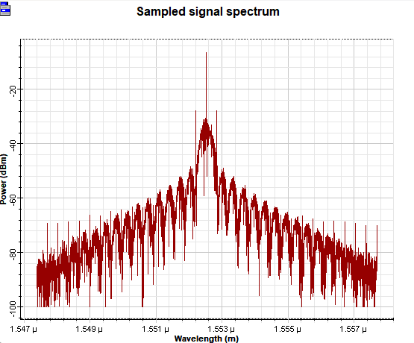
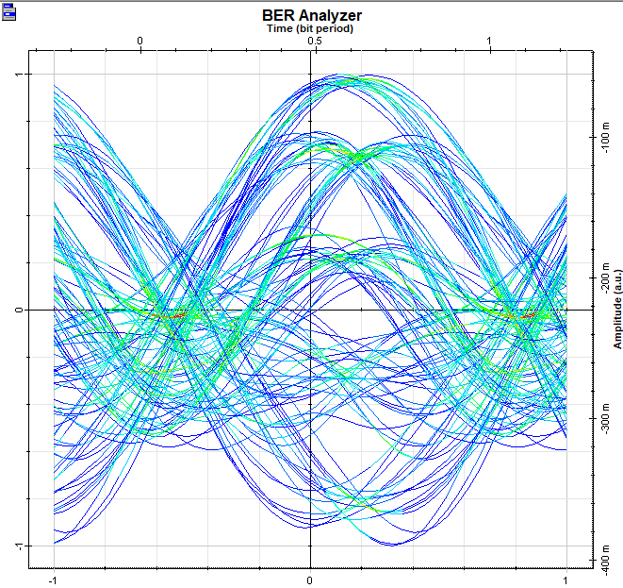
Implementation and Results – Iteration 1
Implementation and Results – Iteration 1
Iteration 1 : Results
Summary of simulation outcomes:
BER results and graphical representations (eye diagrams, constellation diagrams).
SNR measurements across distances.
Performance comparison with other modulation techniques.
8

Slide 9
Implementation and Results – Iteration 2
Iteration 2 : Results
Summary of simulation outcomes:
Refined BER Analysis : Further evaluation with enhanced noise models and coding techniques.
Advanced Graphical Representations : Improved eye diagrams and constellation diagrams under varying noise conditions.
SNR Measurements with Interference Consideration : Additional SNR analysis incorporating channel impairments and interference effects.
Throughput and Latency Analysis : Performance assessment including bit rate efficiency and delay variations.
Extended Performance Comparison :Comparing DPSK, QAM to identify optimal transmission schemes.

Slide 10
Contribution
Team Progress and Movement
Ongoing the circuit modelling and initial simulations.
Conducted experimental validations on DPSK
Integrated III-V heterostructures with surface
functionalization strategies for DPSK Fiber communication

Slide 11
Conclusion & Future Work
Summary and Conclusion
Recap of objectives and findings.
Effectiveness of DPSK modulation for high-speed fiber optic communication.
Contribution to the field of optical communications.
Future Work
Exploration of higher bit rates beyond 40 GHz.
Investigating advanced dispersion compensation techniques.
Development of hybrid modulation schemes to enhance performance.

Slide 12
THANK YOU
Have a Great Day !

